Slide 1
Python
Decision Making
Session 2

Slide 2
Objectives
Decision Makings

Slide 3
Standard Data Types
The data stored in memory can be of many types. For example, a person's age is stored as a numeric value and his or her address is stored as alphanumeric characters.
Python has various standard data types that are used to define the operations possible on them and the storage method for each of them.
Python has five standard data types −
  Numbers
  String
  List
  Tuple
  Dictionary

Slide 4
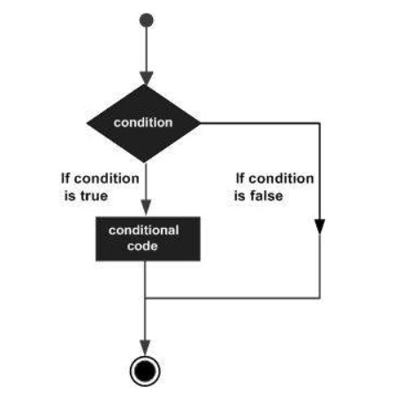
Python - Decision Making
Decision making is anticipation of conditions occurring while execution of the program and specifying actions taken according to the conditions.
Decision structures evaluate multiple expressions which produce TRUE or FALSE as outcome. You need to determine which action to take and which statements to execute if outcome is TRUE or FALSE otherwise.
Following is the general form of a typical decision making structure found in most of the programming languages −

Slide 5
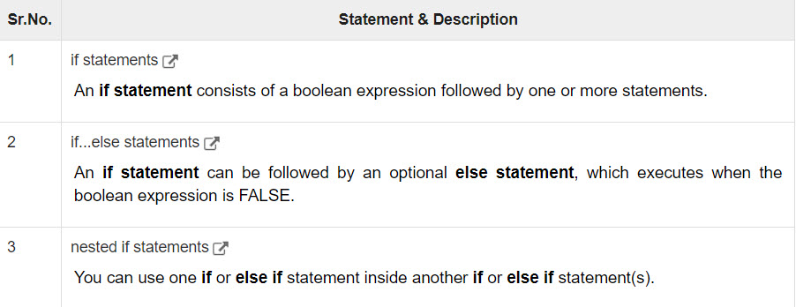
Python - Decision Making
Python programming language assumes any non-zero and non-null values as TRUE, and if it is either zero or null, then it is assumed as FALSE value.
Python programming language provides following types of decision making statements.

Slide 6

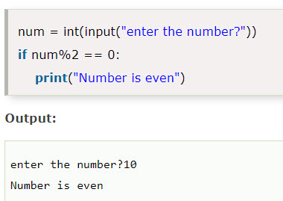
Python - Decision Making
The if statement
  The if statement is used to test a particular condition and if the condition is true, it executes a block of code known as if-block. The condition of if statement can be any valid logical expression which can be either evaluated to true or false.
  Syntax:
  Example:

Slide 7
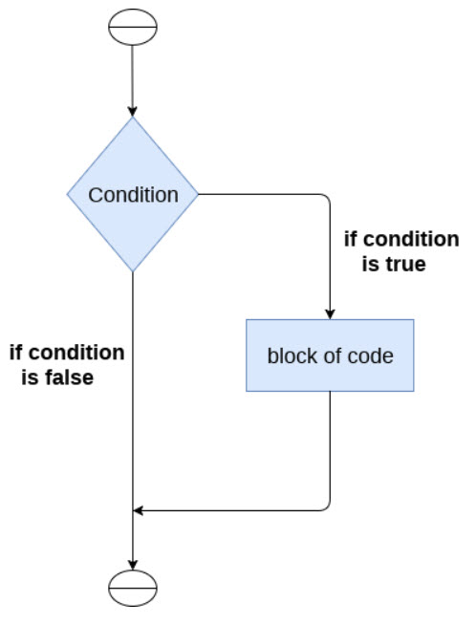
Python - Decision Making
The if statement
  Flowchart:

Slide 8
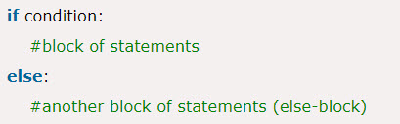
Python - Decision Making
The if-else statement
  The if-else statement provides an else block combined with the if statement which is executed in the false case of the condition.
  If the condition is true, then the if-block is executed. Otherwise, the else-block is executed.
  Syntax:

Slide 9
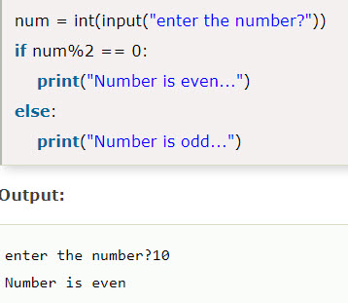
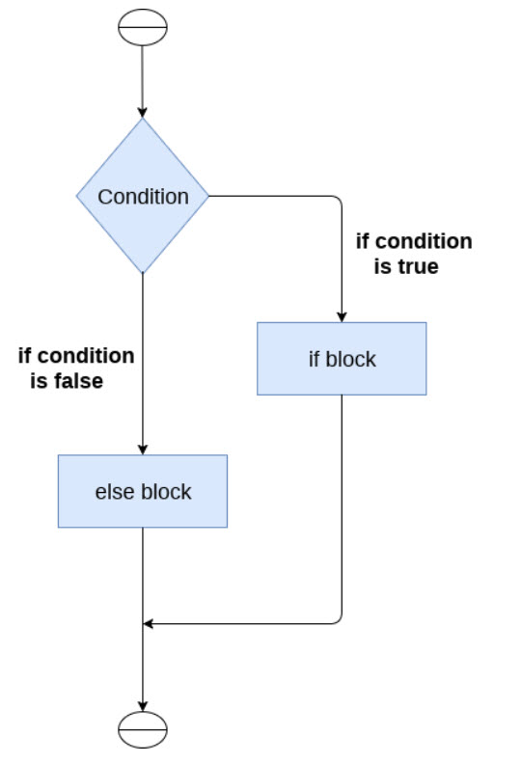
Python - Decision Making
The if-else statement
  Example:
  Flowchart:

Slide 10
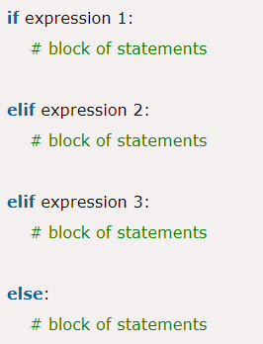
Python - Decision Making
The elif statement
  The elif statement enables us to check multiple conditions and execute the specific block of statements depending upon the true condition among them. We can have any number of elif statements in our program depending upon our need. However, using elif is optional.
  The elif statement works like an if-else-if ladder statement in C. It must be succeeded by an if statement.
  Syntax:

Slide 11
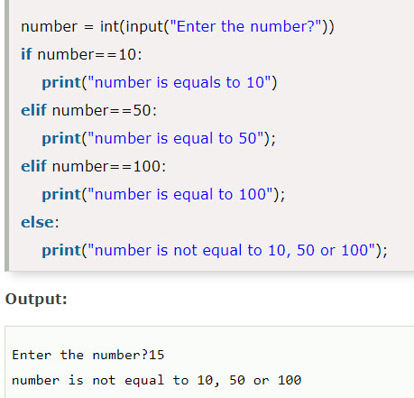
Python - Decision Making
The elif statement
  Example:

Slide 12
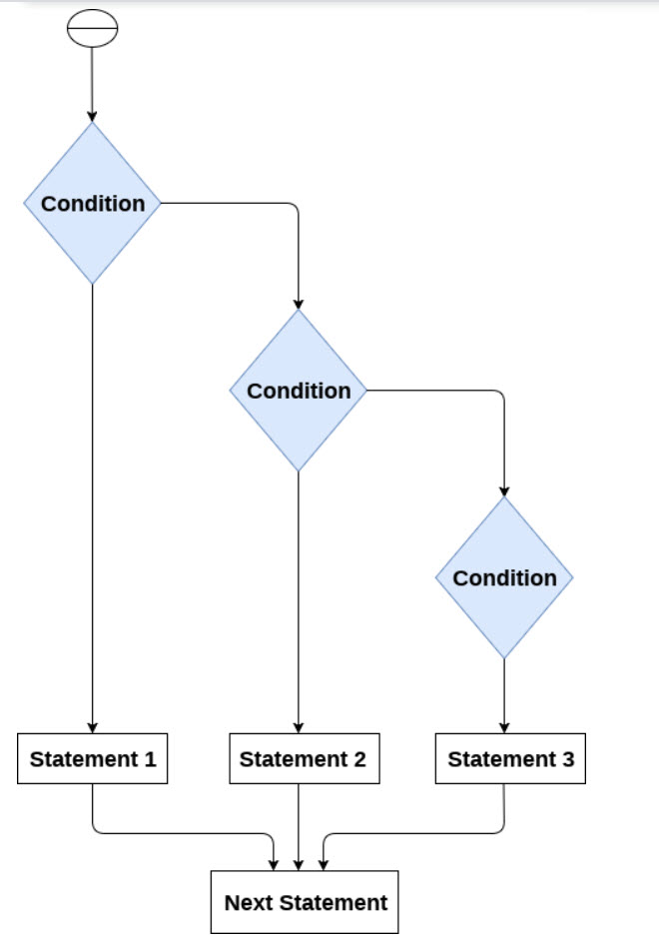
Python - Decision Making
The elif statement
  Flowchart:

Slide 13
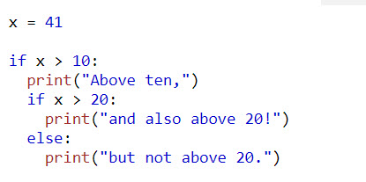
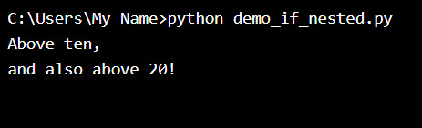
Nested If
If we have if statements inside another if statements, we can call as nested if statements.
  Example:
  Output:

Slide 14
Summary
Decision Makings

